Slide 1



Arrays
http://csharpfundamentals.telerik.com
Processing Sequences of Elements
Svetlin Nakov
Technical Trainer
www.nakov.com
Telerik Software Academy
academy.telerik.com

Slide 2

Table of Contents
Declaring and Creating Arrays
Accessing Array Elements
Console Input and Output of Arrays
Iterating Over Arrays Using for and foreach
Dynamic Arrays
List<T>
Copying Arrays

Slide 3

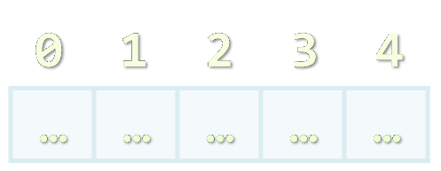

Declaring and Creating Arrays

Slide 4

What are Arrays?
An array is a sequence of elements
All elements are of the same type
The order of the elements is fixed
Has fixed size (Array.Length)
Element of an array
0 1 2 3 4
Element index
Array of 5 elements
… | … | … | … | …

Slide 5

Declaring Arrays
Declaration defines the type of the elements
Square brackets [] mean "array"
Examples:
Declaring array of integers:
Declaring array of strings:
int[] myIntArray;
string[] myStringArray;

Slide 6

Creating Arrays
Use the operator new
Specify array length
Example creating (allocating) array of 5 integers:
myIntArray = new int[5];
0 1 2 3 4
myIntArray
… | … | … | … | …
managed heap
(dynamic memory)

Slide 7
Creating and Initializing Arrays
Creating and initializing can be done together:
The new operator is not required when using curly brackets initialization
myIntArray = {1, 2, 3, 4, 5};
0 1 2 3 4
myIntArray
1 | 2 | 3 | 4 | 5
managed heap
(dynamic memory)

Slide 8

Creating Array – Example
Creating an array that contains the names of the days of the week
string[] daysOfWeek =
{
"Monday",
"Tuesday",
"Wednesday",
"Thursday",
"Friday",
"Saturday",
"Sunday"
};

Slide 9



Days of Week
Live Demo

Slide 10

Accessing Array Elements
Read and Modify Elements by Index
‹#›

Slide 11
How to Access Array Element?
Array elements are accessed using the square brackets operator [] (indexer)
Array indexer takes element’s index as parameter
The first element has index 0
The last element has index Length-1
Array elements can be retrieved and changed by the [] operator

Slide 12
Reversing an Array – Example
Reversing the contents of an array
int[] array = new int[] {1, 2, 3, 4, 5};
// Get array size
int length = array.Length;
// Declare and create the reversed array
int[] reversed = new int[length];
// Initialize the reversed array
for (int index = 0; index < length; index++)
{
reversed[length-index-1] = array[index];
}

Slide 13
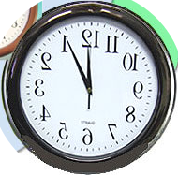

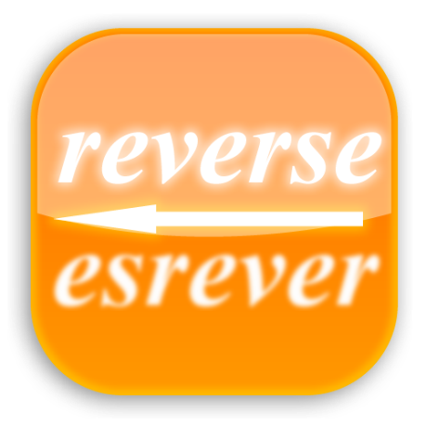
Reversing an Array
Live Demo

Slide 14
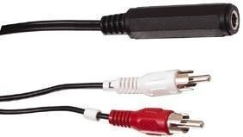
Arrays: Input and Output
Reading and Printing Arrays on the Console

Slide 15
Reading Arrays From the Console
First, read from the console the length of the array
Next, create the array of given size and read its elements in a for loop
int n = int.Parse(Console.ReadLine());
int[] arr = new int[n];
for (int i=0; i<n; i++)
{
arr[i] = int.Parse(Console.ReadLine());
}

Slide 16
Symmetry Check – Example
Read int array from the console and check if it is symmetric:
1 | 2 | 2 | 1
1 | 2 | 3 | 2 | 1
1 | 2 | 3 | 3 | 2 | 1
bool isSymmetric = true;
for (int i=0; i<array.Length/2; i++)
{
if (array[i] != array[n-i-1])
{
isSymmetric = false;
}
}

Slide 17

Symmetry Check
Live Demo

Slide 18
Printing Arrays on the Console
Process all elements of the array
Print each element to the console
Separate elements with white space or a new line
string[] array = {"one", "two", "three"};
// Process all elements of the array
for (int index = 0; index < array.Length; index++)
{
// Print each element on a separate line
Console.WriteLine("element[{0}] = {1}",
index, array[index]);
}

Slide 19

Printing Arrays
Live Demo

Slide 20
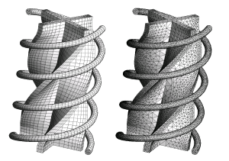
Processing Array Elements Using for and foreach

Slide 21
Processing Arrays: for Statement
Use for loop to process an array when
Need to keep track of the index
Processing is not strictly sequential from the first to the last element
In the loop body use the element at the loop index (array[index]):
for (int index = 0; index < array.Length; index++)
{
squares[index] = array[index] * array[index];
}

Slide 22
Processing Arrays Using for Loop – Examples
Printing array of integers in reversed order:
Initialize all array elements with their corresponding index number:
Console.WriteLine("Reversed: ");
for (int i = array.Length-1; i >= 0; i--)
{
Console.Write(array[i] + " ");
}
// Result: 5 4 3 2 1
for (int index = 0; index < array.Length; index++)
{
array[index] = index;
}

Slide 23

Processing Arrays: foreach
How foreach loop works?
type – the type of the element
value – local name of variable
array – processing array
Used when no indexing is needed
All elements are accessed one by one
Elements can not be modified (read only)
foreach (type value in array)

Slide 24
Processing Arrays Using foreach – Example
Print all elements of a string[] array:
string[] capitals =
{
"Sofia",
"Washington",
"London",
"Paris"
};
foreach (string capital in capitals)
{
Console.WriteLine(capital);
}

Slide 25

Processing Arrays
Live Demo

Slide 26
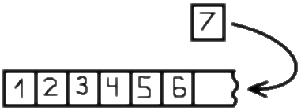

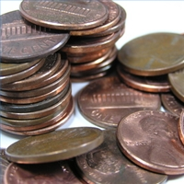
Resizable Arrays
List<T>

Slide 27
Lists (Resizable Arrays)
List<T> – array that can resize dynamically
When adding or removing elements
Also have indexers [] (like arrays)
T is the type that the list will hold
E.g. List<int> will hold integers
List<object> will hold objects
Basic methods and properties
Add(T element) – adds new element to the end
Remove(element) – removes the element
Count – returns the current size of the list

Slide 28
List Example
List<int> intList = new List<int>();
for( int i=0; i<5; i++)
{
intList.Add(i);
}
Is the same as:
int[] intArray = new int[5];
for( int i=0; i<5; i++)
{
intArray[i] = i;
}
The main difference
When using lists we don't have to know the exact number of elements

Slide 29
Lists vs. Arrays
Lets have an array with capacity of 5 elements
If we want to add a sixth element (we have already added 5) we have to manually resize
With List<T> we simply call
int[] intArray = new int[5];
int[] copyArray = intArray;
int[] intArray = new int[6];
for (int i = 0; i < 5; i++)
{
intArray[i] = copyArray[i];
}
intArray[5] = newValue;
list.Add(newValue);

Slide 30


Lists <T>
Live Demo

Slide 31
How The List<T> Works?
Why adding new elements is not slow?
When adding n elements in List<T> it resizes itself log₍₂₎n times instead of n
Initially a new List<T> has size of 0 elements
Counter for total capacity (Capacity)
Counter for number of used capacity (Count)
When created, both properties of the list have values of 0
When adding the first element Count becomes 1 and Capacity becomes 4

Slide 32



How The List<T> Works? (2)
Initially the List<T> is empty
When adding new element it is resized
But not every time
Only when it is needed
Lets have a list with 3 elements
It looks like this:
When we add new element it is appended to the end
Adding a fifth element doubles the Capacity of the list

Slide 33


Resizing Lists
Live Demo

Slide 34



Copying Arrays
The Array Class

Slide 35
Copying Arrays
Sometimes we must copy the values from one array to another one
If we do it the intuitive way we would copy not only the values but the reference to the array
Changing some of the values in one array will affect the other
The way to avoid this is using Clone()
This way only the values will be copied but not the reference
int[] copyArray = array;
int[] copyArray = (int[])array.Clone();

Slide 36
Summary
Arrays are a fixed-length sequences of elements of the same type
Array elements are accessible by index
Can be read and modified
Iteration over array elements can be done with for and foreach loops
List<T> holds resizable arrays
Good when we don't know the number of elements initially

Slide 37





Arrays
http://csharpfundamentals.telerik.com

Slide 38
Exercises
Write a program that allocates array of 20 integers and initializes each element by its index multiplied by 5. Print the obtained array on the console.
Write a program that reads two arrays from the console and compares them element by element.
Write a program that compares two char arrays lexicographically (letter by letter).
Write a program that finds the maximal sequence of equal elements in an array.
Example: {2, 1, 1, 2, 3, 3, 2, 2, 2, 1} 🡪 {2, 2, 2}.

Slide 39
Exercises (2)
Write a program that finds the maximal increasing sequence in an array. Example: {3, 2, 3, 4, 2, 2, 4} 🡪 {2, 3, 4}.
Write a program that reads two integer numbers N and K and an array of N elements from the console. Find in the array those K elements that have maximal sum.
Sorting an array means to arrange its elements in increasing order. Write a program to sort an array. Use the "selection sort" algorithm: Find the smallest element, move it at the first position, find the smallest from the rest, move it at the second position, etc.

Slide 40
Exercises (3)
Write a program that finds the sequence of maximal sum in given array. Example:
{2, 3, -6, -1, 2, -1, 6, 4, -8, 8} 🡪 {2, -1, 6, 4}
Can you do it with only one loop (with single scan through the elements of the array)?
Write a program that finds the most frequent number in an array. Example:
{4, 1, 1, 4, 2, 3, 4, 4, 1, 2, 4, 9, 3} 🡪 4 (5 times)
Write a program that finds in given array of integers a sequence of given sum S (if present). Example: {4, 3, 1, 4, 2, 5, 8}, S=11 🡪 {4, 2, 5}

Slide 41
Exercises (6)
Write a program that finds the index of given element in a sorted array of integers by using the binary search algorithm (find it in Wikipedia).
Write a program that creates an array containing all letters from the alphabet (A-Z). Read a word from the console and print the index of each of its letters in the array.
* Write a program that sorts an array of integers using the merge sort algorithm (find it in Wikipedia).
Write a program that sorts an array of strings using the quick sort algorithm (find it in Wikipedia).

Slide 42
Exercises (7)
Write a program that finds all prime numbers in the range [1...10 000 000]. Use the sieve of Eratosthenes algorithm (find it in Wikipedia).
* We are given an array of integers and a number S. Write a program to find if there exists a subset of the elements of the array that has a sum S. Example:
arr={2, 1, 2, 4, 3, 5, 2, 6}, S=14 🡪 yes (1+2+5+6)
* Write a program that reads three integer numbers N, K and S and an array of N elements from the console. Find in the array a subset of K elements that have sum S or indicate about its absence.

Slide 43
Exercises (8)
* Write a program that reads an array of integers and removes from it a minimal number of elements in such way that the remaining array is sorted in increasing order. Print the remaining sorted array. Example:
{6, 1, 4, 3, 0, 3, 6, 4, 5} 🡪 {1, 3, 3, 4, 5}
* Write a program that reads a number N and generates and prints all the permutations of the numbers [1 … N]. Example:
n = 3 🡪 {1, 2, 3}, {1, 3, 2}, {2, 1, 3}, {2, 3, 1}, {3, 1, 2}, {3, 2, 1}

Slide 44
Exercises (9)
Write a program that reads two numbers N and K and generates all the variations of K elements from the set [1..N]. Example:
N = 3, K = 2 🡪 {1, 1}, {1, 2}, {1, 3}, {2, 1}, {2, 2}, {2, 3}, {3, 1}, {3, 2}, {3, 3}
Write a program that reads two numbers N and K and generates all the combinations of K distinct elements from the set [1..N]. Example:
N = 5, K = 2 🡪 {1, 2}, {1, 3}, {1, 4}, {1, 5}, {2, 3}, {2, 4}, {2, 5}, {3, 4}, {3, 5}, {4, 5}

Slide 45



Free Trainings @ Telerik Academy
“C# Programming @ Telerik Academy
csharpfundamentals.telerik.com
Telerik Software Academy
academy.telerik.com
Telerik Academy @ Facebook
facebook.com/TelerikAcademy
Telerik Software Academy Forums
forums.academy.telerik.com

